Slide 1
Writing a Business Plan
Business Plans for Freelancers – Part 2
Notes:
Don’t add the author or date to the title slide. Add that information in the notes here:
Author: Sam Cartwright – samc@aie.edu.au
Creation Date: 26/07/2022
Modification Date:

Slide 2
Contents
Parts of a Business Plan (again)
High-level Financial Planning
Key Personnel
Goals & Action Plans

Slide 3

Parts of a Business Plan
We will now cover the parts in blue:
Business Summary and Purpose
Market Opportunity
Target Market
Marketing & Communication Channels
Competitive Analysis
Financial Planning
Key Personnel
Goals & Action Plans

Slide 4

Financial Planning
Let’s be real – Financial planning is something that people do very carefully before they actually launch a business or decide they are going to live as a freelancer or contractor.
As someone looking to work as a digital creative, it is extremely important that you have an understanding of how budget planning for businesses, freelancers and projects work.

Slide 5
Financial Planning – Universal basics
A good financial plan allows you to utilize your budget and prioritise spending
Detail, as accurately as possible:
What is your monthly/annual revenue?
What are the major expenses for your business?
What are your marketing, travel, or home office costs?
What is the cost of supplies, equipment or software?
What do your sub-contractors cost? Or your wages?

Slide 6
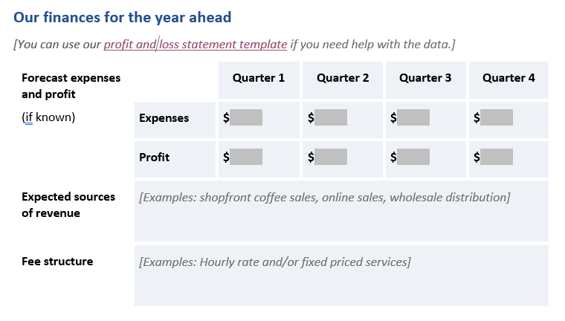
Financial Planning – Sources of revenue
Digital creatives need to outline the details of their service offerings and products.
Contract businesses and freelancers tend to stick to focusing on services for income sources.
Do you create content, or are you a freelance writer?
Are you a mobile developer, Unity developer, or programmer?
Are you a concept artist, 2D artist, modeler or animator?
Develop a brief description of each service you plan to offer. Explain what you’ll do and the process you’ll use.
Use the ‘Expected sources of revenue’ section of the template.

Slide 7
Sources of revenue – Tips!
When considering revenue sources, be aware:
Research here is easy! Look to see what services are out there.
You probably want scalable sources of revenue. This means you can take on bigger jobs either for more money, or maybe a more competitive rate if it’s big enough.
You probably want multiple revenue sources. Imagine if you ran a business that relied purely on developing film for photography.
You should sanity check that you can actually provide any services you list.

Slide 8
Financial Planning - Fee Structures
Fee structures are an important aspect of the freelancer’s business plan and need to be seriously considered
You need to be realistic about them in order to maximise your potential work.
In order to establish your fee structure, you should:
Assess your experience and expertise. Your chosen rates must reflect this.
Research others in the same business and their fee structures.
Consult with professional organisations and unions in your sector to get information about any standard or minimum rates.

Slide 9
Financial Planning - Fee Structures
Come up with a realistic estimation of how much you need to earn to live well and how much work you can realistically take on and do well.
With this information you can set some realistic fees that make you competitive without selling yourself short or overworking in order to survive.
Businesses have quite different possibilities when it comes to survival compared to a freelancer.
Use the ‘Fee structure’ section of the template.

Slide 10
Fee structures – Tips!
When establishing fee structures sources, consider that:
The most important thing here is structure. How are you fees structured? Hourly? Fixed amount? A retainer? This is easier to answer than the exact fees themselves.
If you provide something truly unique, highly skilled or qualified, or absolutely vital to your market, you can charge more.
If your market solution is ‘cheaper’ or ‘budget’, then your fee structure needs to consider that point.

Slide 11
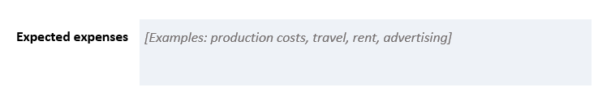
Financial Planning – Expected Expenses
The last thing you need to actually prepare a financial forecast is to be across your expected expenses – Your outgoings.
Like your revenue, this will require some thought and research to make sure you have covered everything. Failing to realise where your outgoings will be as a business or freelancer can be a serious problem. Don’t rush this part!
Use the ‘Expected expenses’ section of the template. Be as exhaustive as you can.

Slide 12
Expected expenses – Tips!
When coming up with your expenses, consider that:
Wages for staff are often the biggest expenses for most businesses. If you need to live off a freelance wage, the same applies.
Digital creatives tend to have reasonably sizable hardware and software expenses. You need commercial licenses to work commercial contracts and jobs. Many of these are monthly too.
Research this if you have no experience! The Profit and loss statement template provided can help with ideas.

Slide 13
Financial Planning – Forecast
Only now that you have done the other points can you now produce a financial forecast for the year.
In our template, this is the ‘Forecast expenses and profit’ section.
This is much easier if you start by following the recommendation of using the profit and loss statement template from business.gov.au – The link is above the forecast fields.

Slide 14
Forecast – Tips!
When coming up with your forecast, consider that:
The profit & loss template will require you to tally things up to calculate the quarterly expenses and profit.
You MUST consider cash flow, especially if planning finances for a freelancer. Be ready for client payments to take longer than the job itself.
Being real with your expenses helps you identify baseline targets for your income so you can make a profit.
It is extremely common for starting businesses to fall short of their targets. Blind optimism is not useful here. It can take time to develop a client base, which is a part of why many starting businesses fail.

Slide 15
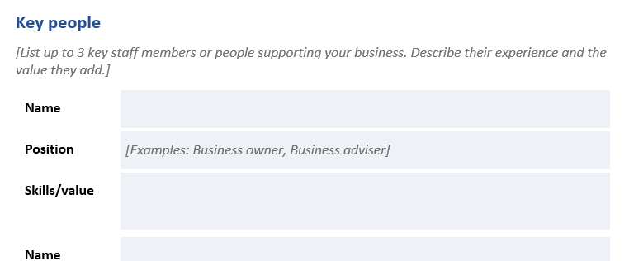
Key People
For a freelancer, it’s typically just themselves, and maybe any sub-contractors they rely upon – But in this exercise you are doing this for an imagined business.
For most start up businesses, you only add people as you need them, as employee wages are expensive. Who are the people your business can’t do without to run at all? Your core team.
Fill out the ‘Key people’ section of the template. Do all 3 people.

Slide 16
Key People – Tips!
When coming up with three key people, consider that:
Many small developers and digital media houses start with small team sizes like this. These are the directors, managers and leads.
You may find it easier to start from roles, as roles tend to dictate the skillsets required for that job.
If you can’t think about who is key, try thinking about who ISN’T key… Who can you just hire or subcontract now and then? Take them away, what roles are left?
In a smaller business, you may have some people who take on more than one role either by necessity, or because they have a wider range of skills. The people are often considered ‘key’.

Slide 17
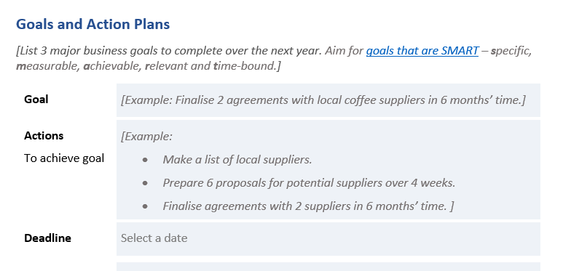
Goals and Action Plans
If you don’t set goals, and plans to reach them, then chances are that you won’t achieve goals. That simple.
You should set SMART goals – Specific, Measurable, Achievable, Relevant, Time-based. These are goals you can set for short-to-mid term goals, something all businesses need.
Fill out the ‘Goals and Action Plans’ section of the template.
Do all fields for all 3 goals.

Slide 18
Goals and Action Plan – Tips!
When coming up with three key people, consider that:
A goal without a viable action plan is a goal you won’t achieve. This won’t work here for assessment.
You need goals that are either about making money, they can’t all just be about preparing to be ready to make money.
What is one of the first things your business can do to scope up either the size of the projects you take on, or the number of them? These are key early goals.
Try to err on the side of ambitious with your deadlines. If you miss conservative deadlines, you will struggle to progress quickly enough to survive.

Slide 19
Your Turn – Go do sections 6-8 now
Any questions?

